Slide 1
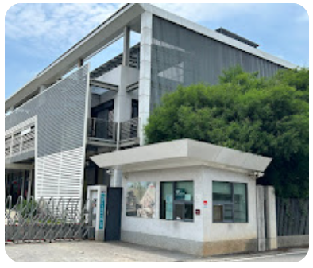
Taiwan Stock Exchange Code：3630
Newmax Technology Co., Ltd
Company Institutional
Investor Conference
2025
2025.12.30

Slide 2
Disclaimer
This briefing and related information released contain predictive information from the company’s internal and external sources.
The actual operating results, financial status and business prospects of the company in the future may differ from the estimates expressed or implied by these predictive information. The reason may come from various risks that the company cannot control.
The outlook for the future in this briefing reflects the company's view of the future so far. For these views, if there are any changes or adjustments in the future, the company is not responsible for remind or update at time
This briefing and its content are not allowed to be accessed without the written consent of the company.

Slide 3
1
2
3
4
Company
Introduction
Operation
Status
Competitive
Advantages
Corporate
Performance

Slide 4

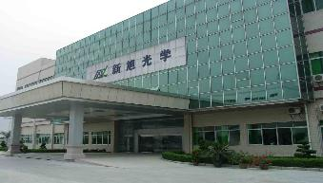
Corporate Introduction- Company Profile
Established: Aug 30, 1999
Chairman： Stock Cheng
General Manager： TC Huang
Capital: NTD 2.04 Billion
Numbers of Employees: 1,300
HQ : No 77, Ln 100, Shuitou 1st Rd., Waipu Dist., Taichung City, Taiwan
Factories : No 236, Wusha, Chiangpei Village, Changan Town, Dongguan City, Guangdong Province, China
Taiwan
Taichung
China
Dongguan

Slide 5






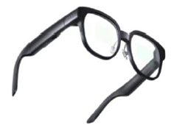

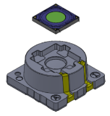



Corporate Introduction- Newmax History
Mobile Lens
Production
13M
Mobile
Folded
Chicony
Takes Lead
of Shareholder
Through Strategic Investment
Xbox Kinect One V2
3D TOF Lens and Window
Exclusive Supplier
Taiwan HQ was moved to Waipu Dist. Taichung City
IPO in Taiwan
Stock Market.
RealSense
Lens
FOD Lens
1999
2004
2009
2010
2011
2013
2014
2015
2017
2018
2020
2024
2025
Company
Established
NB Lens
Market Share
Global No.1
Xbox Kinect V1
3D Structure Light Lens and Window
Exclusive Supplier
Mobile Lens
Production 5M, 8M
Takes Lead
of Shareholder
Through Strategic
Investment
RGB
32M/48M.
&
TOF
AR Glass
Kindle
Flagship
Panel
T-Lens

Slide 6
1
2
3
4
Company
Introduction
Operation
Status
Competitive
Advantages
Corporate
Performance

Slide 7
Operation Status - Product Map
3P, 4P, 5P big volume market.
64M+ High Pixel lens development.
6P, 7P, Hybrid G+P lens.
Super Wide FOV.
Small head front camera.
12M, 8M, 5M, FHD, HD Hybrid
Super narrow Y dimension
Ultra Low TTL
Super micro, wide FOV and low TTL
Strategy IC partner cooperation
High efficiency production
01
02
03
MP RGB
Note Book
MP FOD
CW
IOT
04
05
E-Book
3D Sensing
Car Touch Panel
3D. STL, xToF.
AR/VR/XR
Drone
IP Cam
Cleaning Robot
Intelligent Door Lock
Automotive

Slide 8
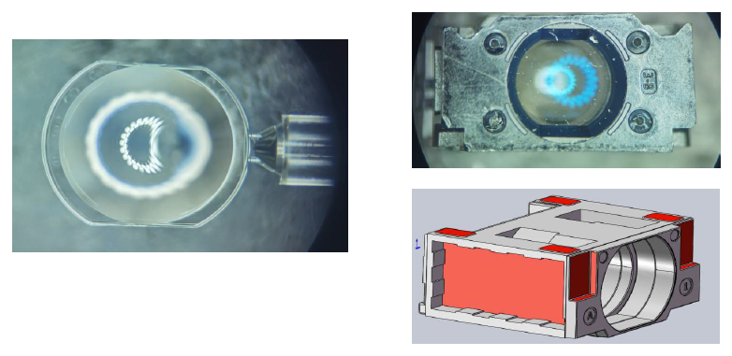

Operation Status - NB Lens
NB Lens
Super Narrow Lens
AI Application

Slide 9
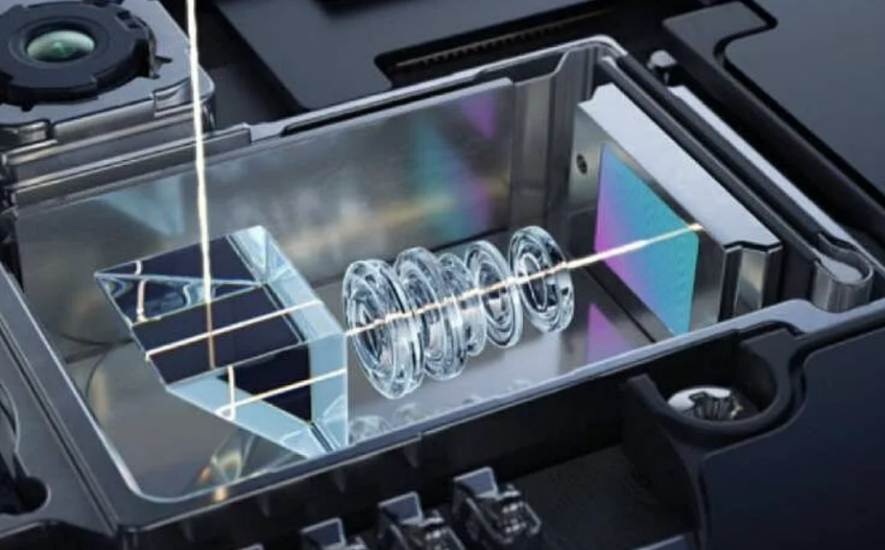
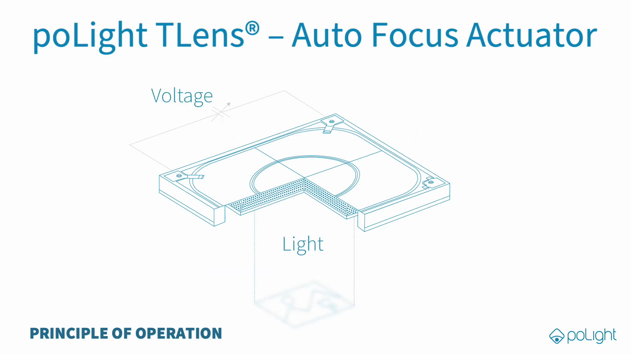
Operation Status - Smartphone Lens
Folded Lens
T Lens Application

Slide 10

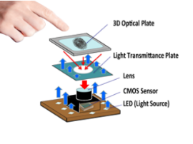
Operation Status - FOD Lens
FOD Lens
Design at Super micro focusing

Slide 11
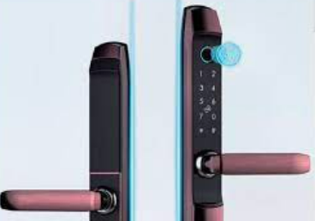
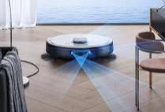
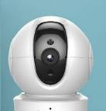


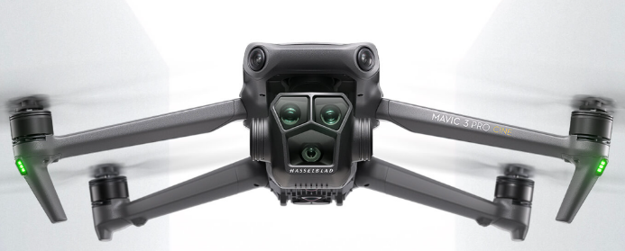


Operation Status - IOT Lens
IOT Products
Intelligent door lock
Cleaning Robotics
Smart Home
AR/VR/XR
Drone
Gesture Recognition
Face ID
Windows Hellow

Slide 12
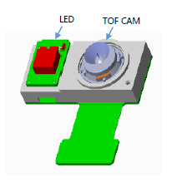
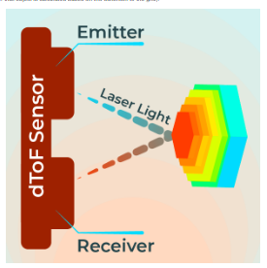

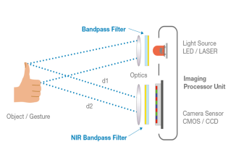
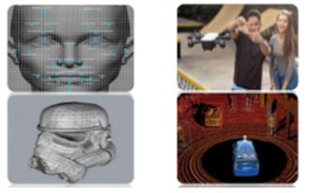
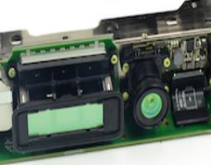
Operation Status - 3D Lenses
Structure Light, ToF & Stereo Vision

Slide 13
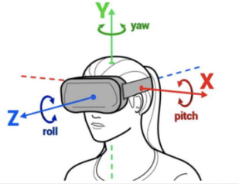
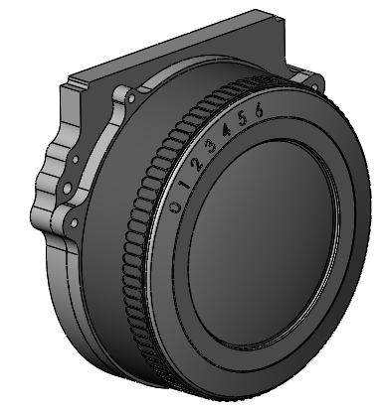
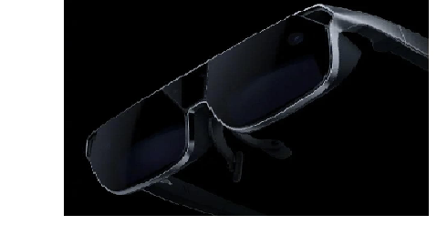
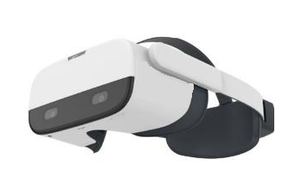
Operation Status - VR, AR and XR
VR Pancake Lens
Head/Hand Tracking 6 DOF/Eyes Tracking Lenses
Valve INDEX

Slide 14

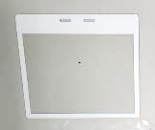
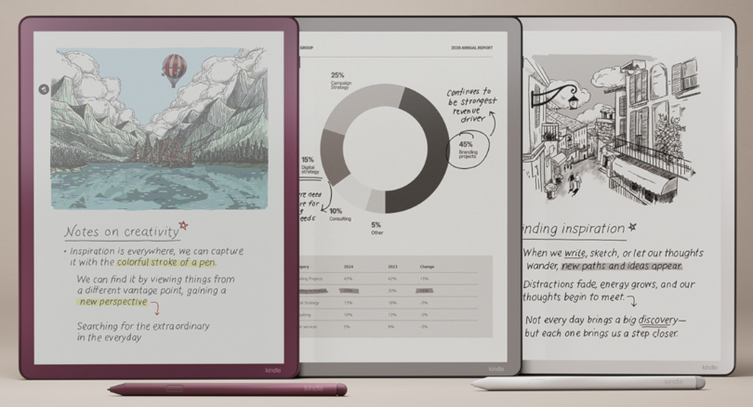
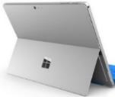
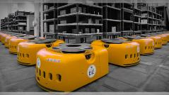
Operation Status - Cover Window
IR Pass high transmittance.
Customizing Optical Coating of AR, AF, AS…..
Production line of NB, Gaming, Car….
Car Touch Panel
Tablet Camera Window
Kindle e-Book Panel
3D Sensing Window

Slide 15
1
2
3
4
Company
Introduction
Operation
Status
Competitive
Advantages
Corporate
Performance

Slide 16
Competitive Advantages - Core Competence
Design
IT
Tiny lens of Super Narrow and D-Cut lens manufacturing.
Optical design capability achieves for custom projects as Periscope, Pancake, and AR.
Servive and efficiency support support customers
MES management to improving production efficiency and develop MES APP for AI tool build模, production control, quality control.
1
2
6
Molding Tool
Equipment
Core Competence
Hi-Tech tools for big lens of Pancake and AR, focus on high yield.
I-Cut tool production
Prism molding development.
Automation inspection line development, focus on production efficiency.
Yield enhancing for cost compentence.
3
5
Coating
Production
Low reflection AR coating technology.
Super black coating on lens barrel.
Metal coating technology.
4
Production line of In-line enhances efficiency.
AOI capacity enhances.

Slide 17
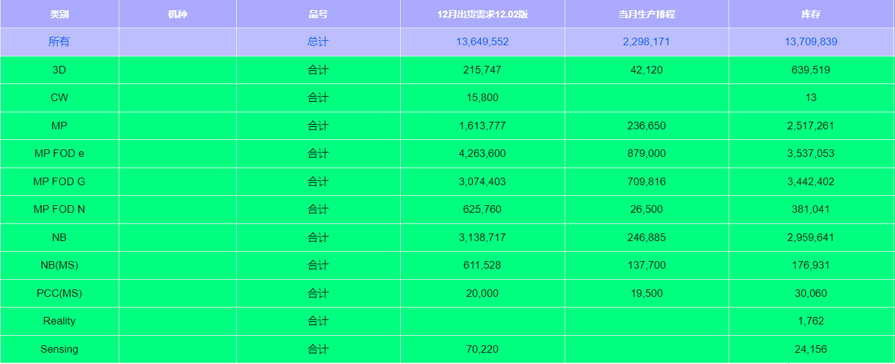
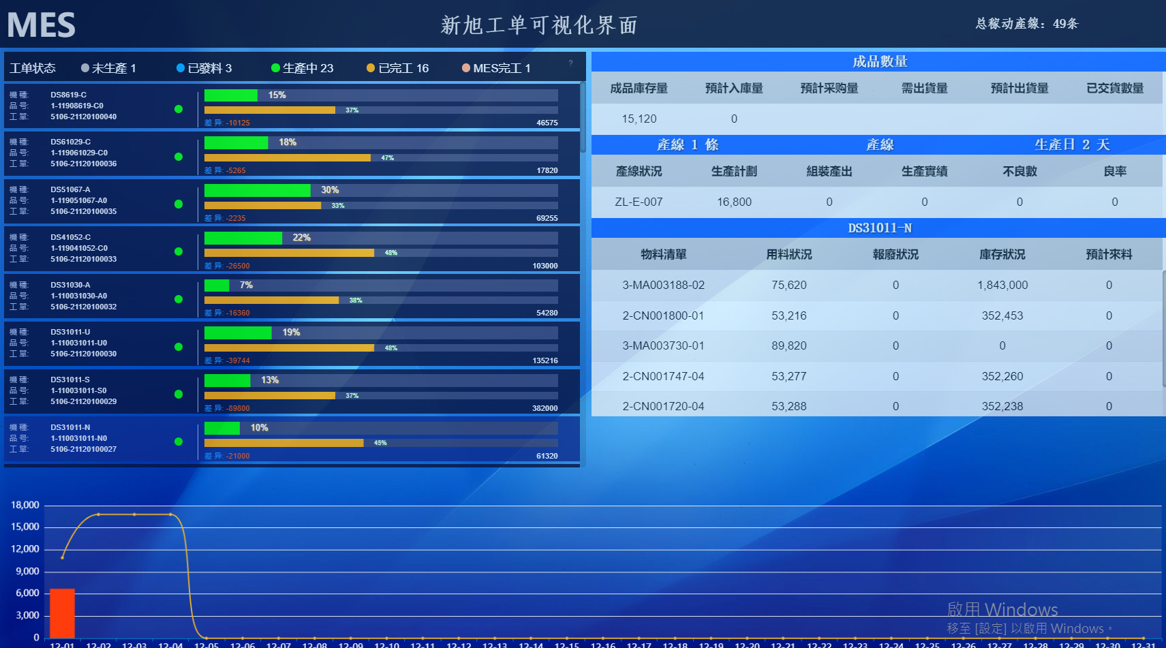
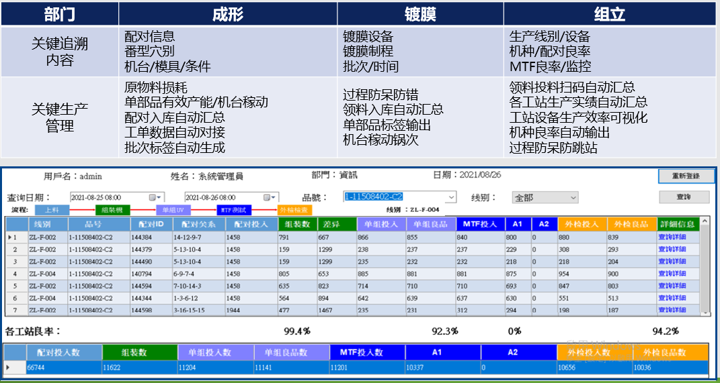
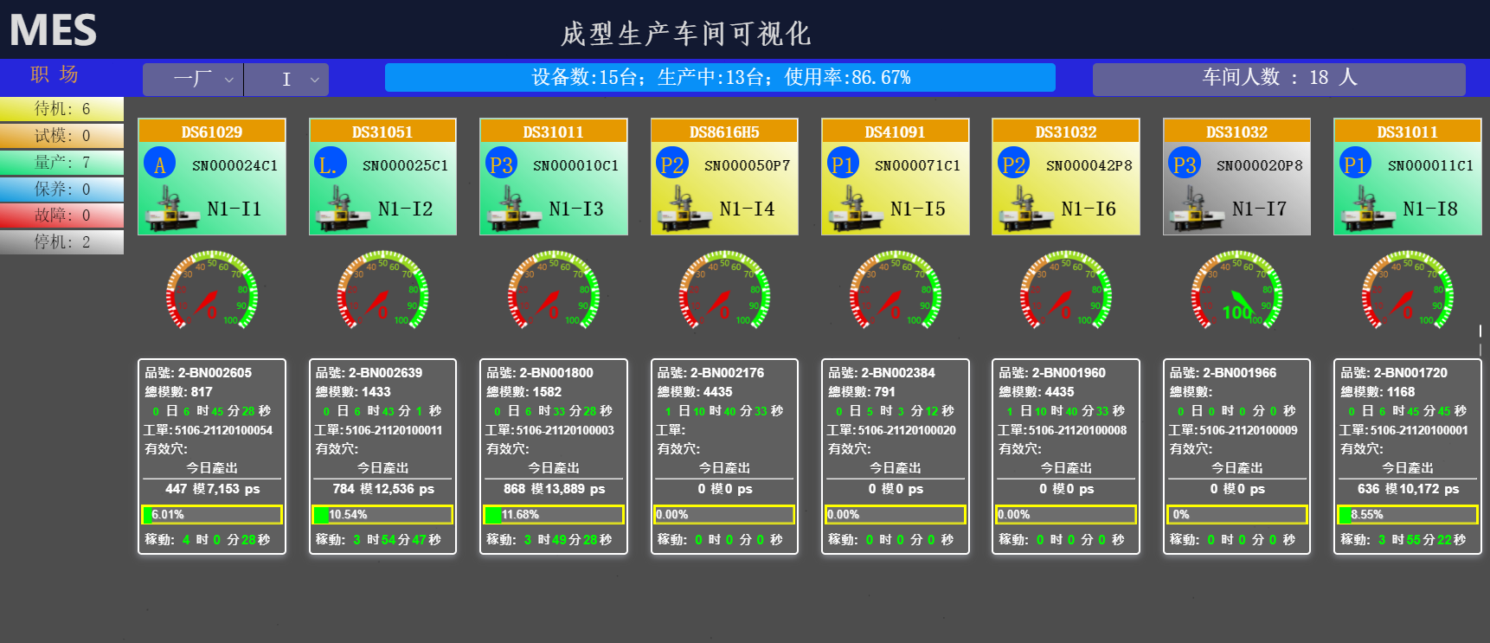
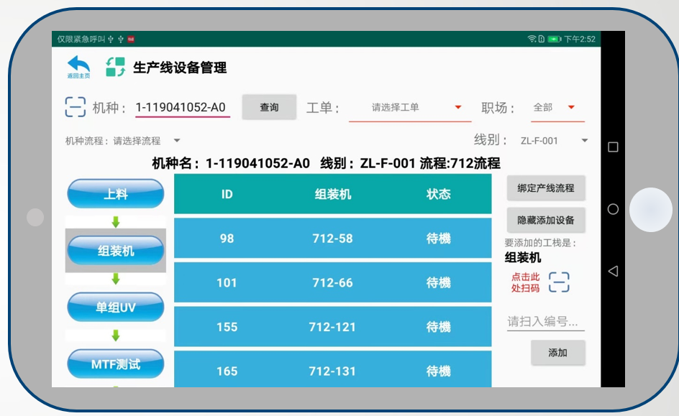
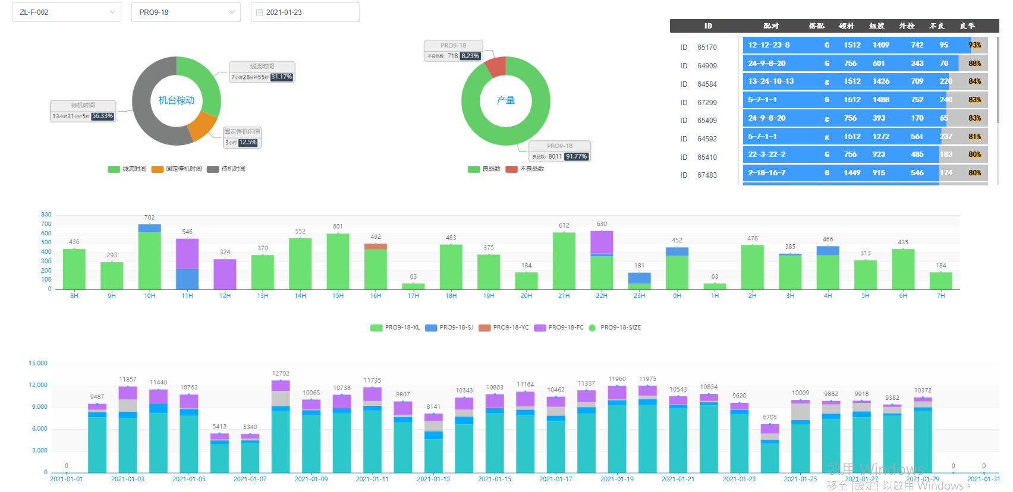
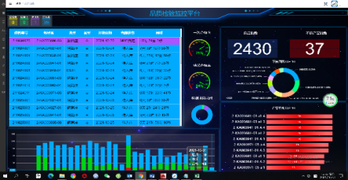
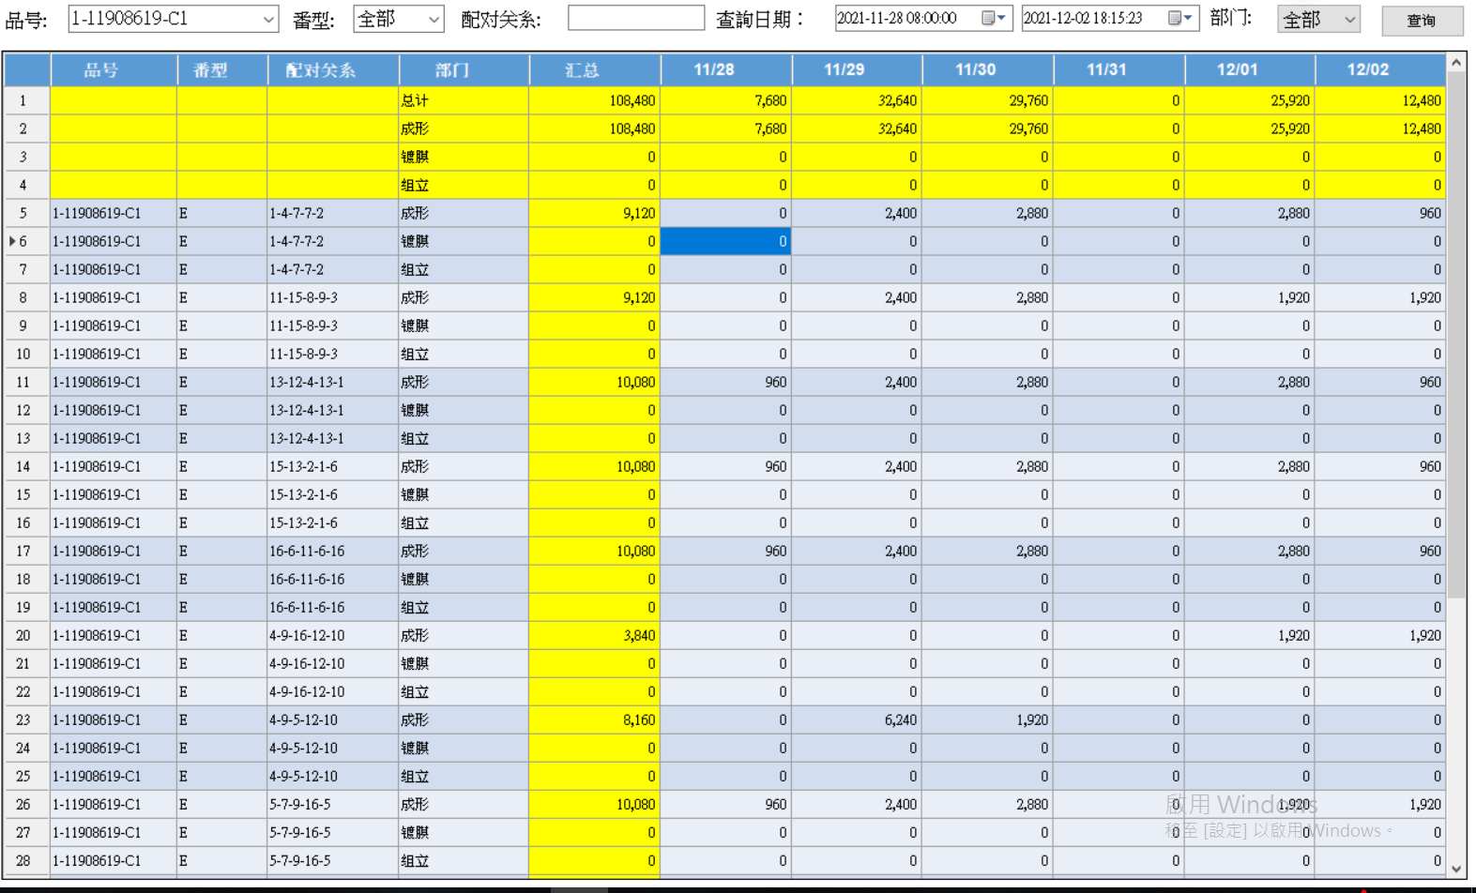
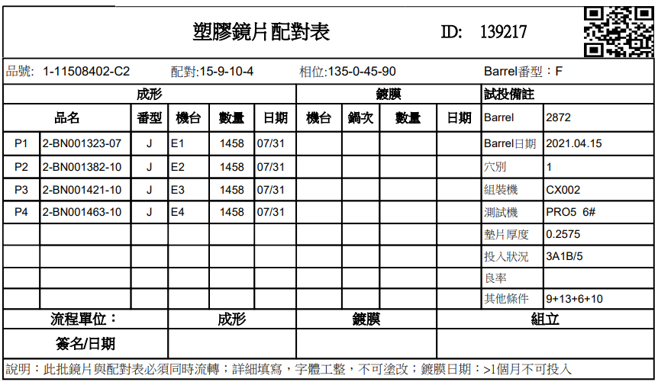
Competitive Advantages - Industry 4.0
Customer demand management
Production schedule management
Production process traceability
Workshop production line management
Industry 4.0
PDCA
Process flow management
Equipment resource management
Quality analysis monitoring
Inventory Material Management

Slide 18
1
2
3
4
Company
Introduction
Operation
Status
Competitive
Advantages
Corporate
Performance

Slide 19
Corporate Performance -
Consolidated Statements of Comprehensive Income
Unit: NT$ thousand
損益 | 2025 | 2024 | Differences Amount
 | Ended September30 Ended September 30
Operating revenue | 1,708,211 | 1,444,226 | 263,985
Gross profit | 162,872 | 73,784 | 89,088
Gross profit rate | 10% | 5%
Operating expenses | 531,423 | 475,906 | 55,517
Loss before income tax | 439,298 | (331,048) | 770,346
Net loss | 439,298 | (331,048) | 770,346
Net loss rate | 26% | -23%
EPS | 2.19 | (1.80)

Slide 20
Corporate Performance – Consolidated Balance Sheets
Unit: NT$ thousand
Assets | September 30, 2025 | % | December 31, 2024 | % | September 30, 2024 | %
Current asset | 2,456,933 | 59 | 1,194,606 | 24 | 1,346,550 | 25
Non-current assets | 1,675,412 | 41 | 3,867,583 | 76 | 4,016,263 | 75
Total assets | 4,132,345 | 100 | 5,062,189 | 100 | 5,362,813 | 100
Liabilities and Equity | September 30, 2025 | % | December 31, 2024 | % | September 30, 2024 | %
Current liabilities | 938,839 | 23 | 1,163,360 | 23 | 1,244,064 | 23
Non-current liabilities | 103,333 | 2 | 1,638,740 | 32 | 1,722,274 | 32
Total liabilities | 1,042,172 | 25 | 2,802,100 | 55 | 2,966,338 | 55
Total shareholders' equity | 3,090,173 | 75 | 2,260,089 | 45 | 2,396,475 | 45

Slide 21
Q & A
THANK YOU

